Slide 1

British Airways Data Science Virtual Internship
Task 1:
The Analysis of Scraped Data
The Results of Sentiment Analysis and Topic Modeling
Written By Aydan Gadirzada

Slide 2
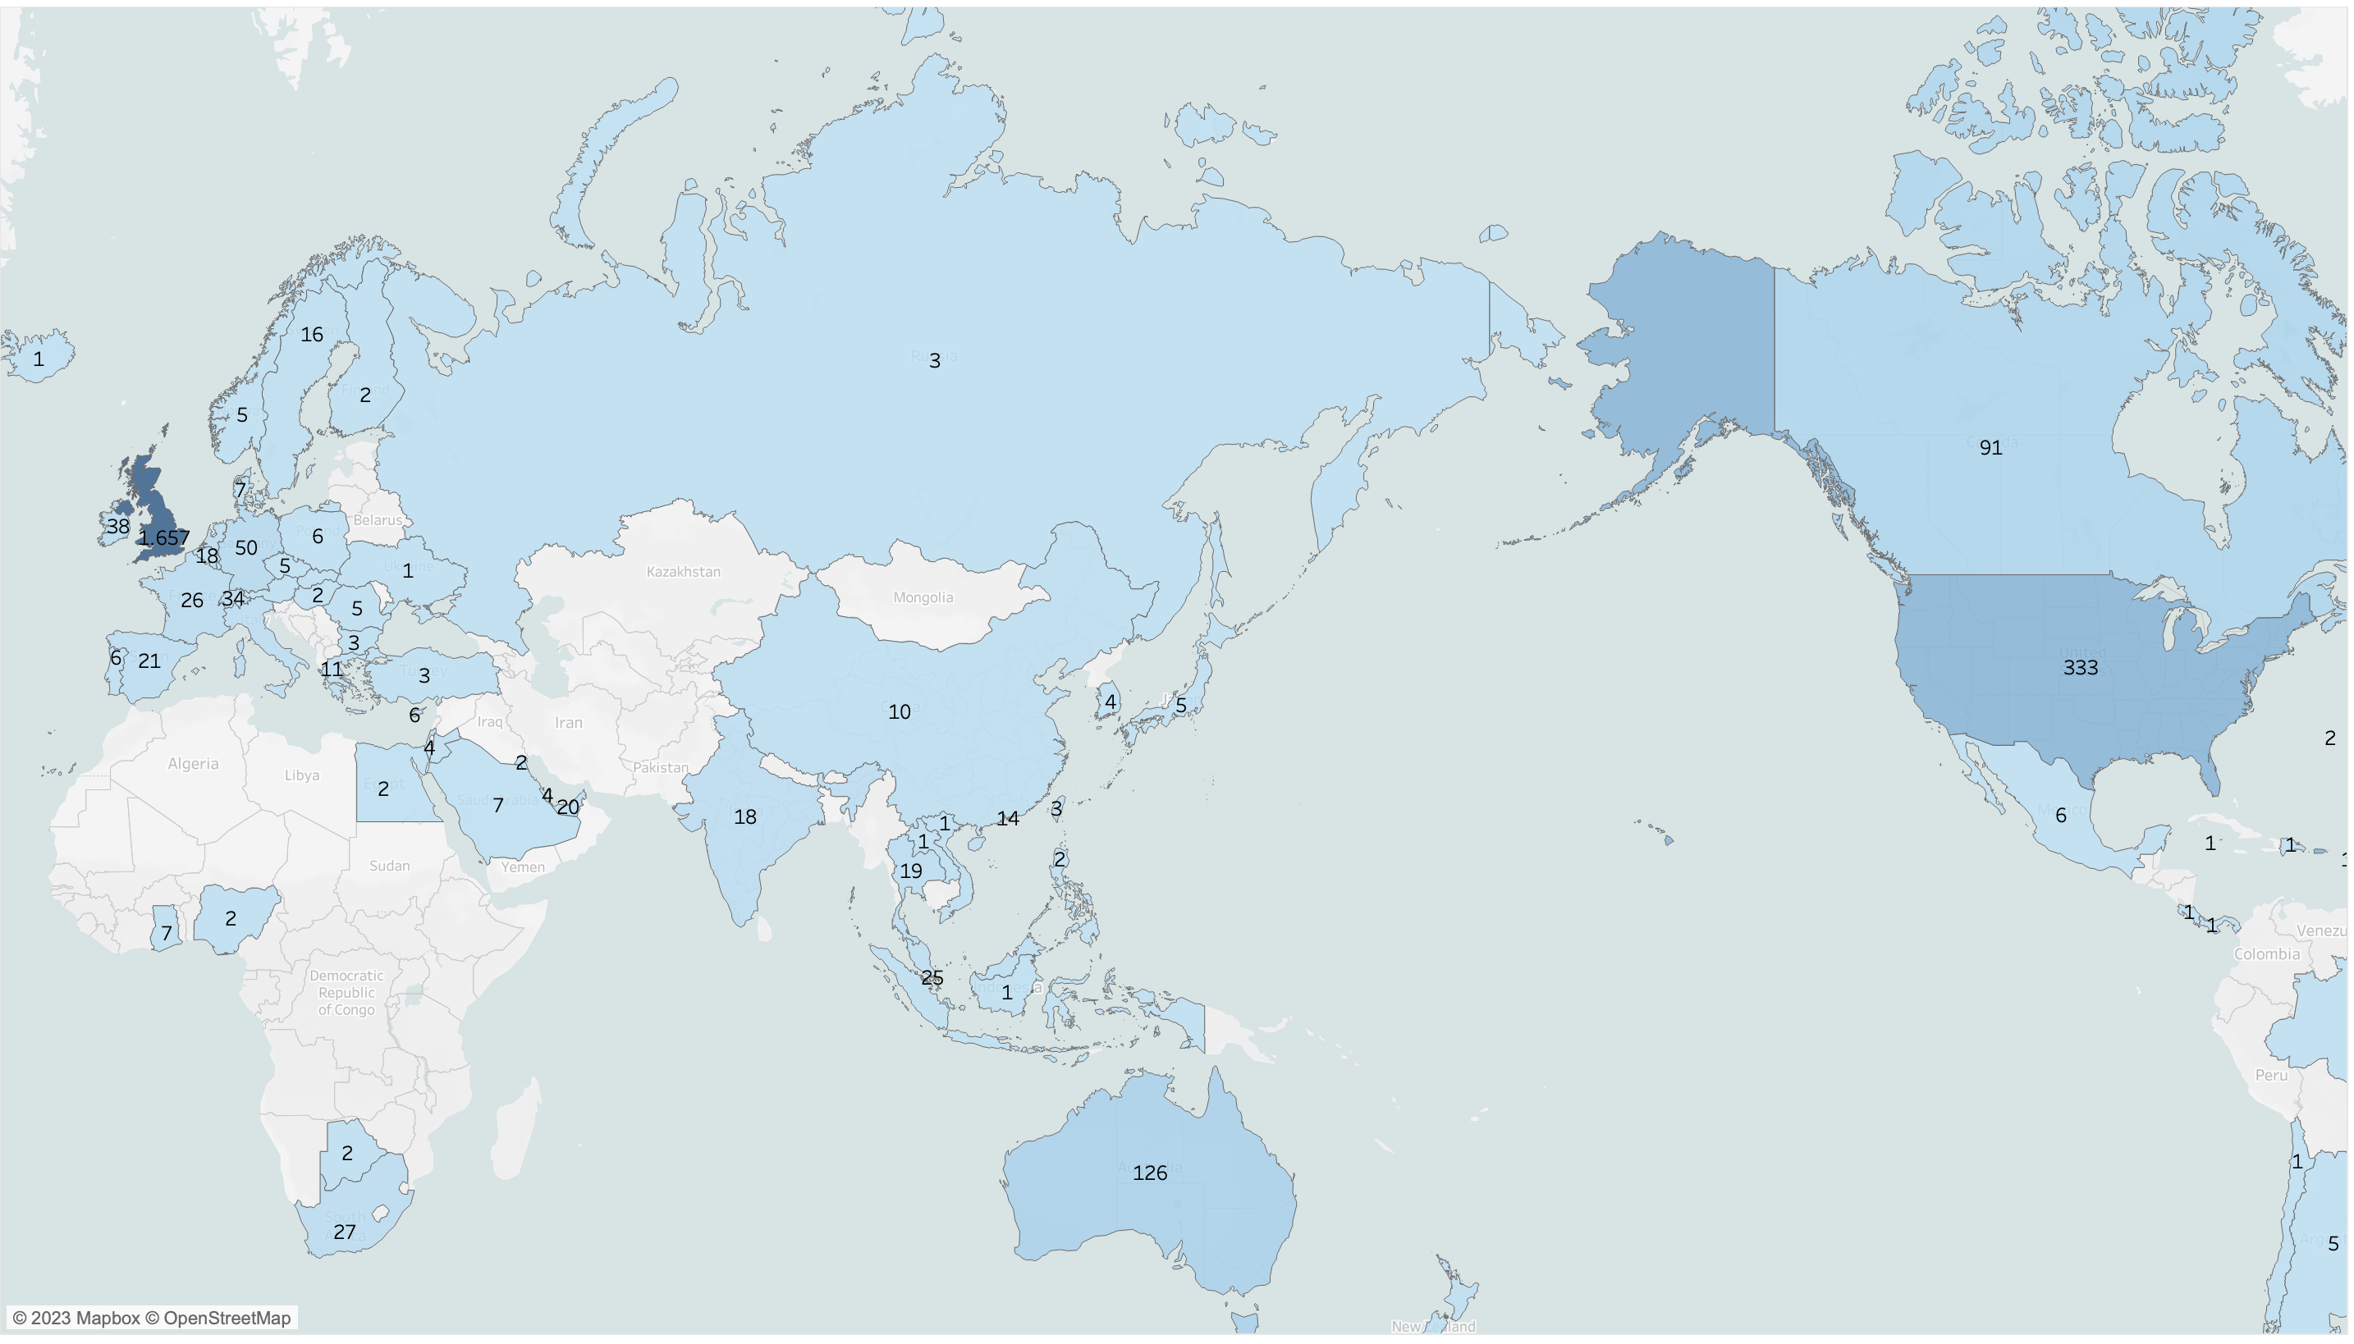
The Number of Distinct Authors per Country
As observed from map, most of the commenters are from United Kingdom (1657 Authors), then USA (333 Authors).

Slide 3
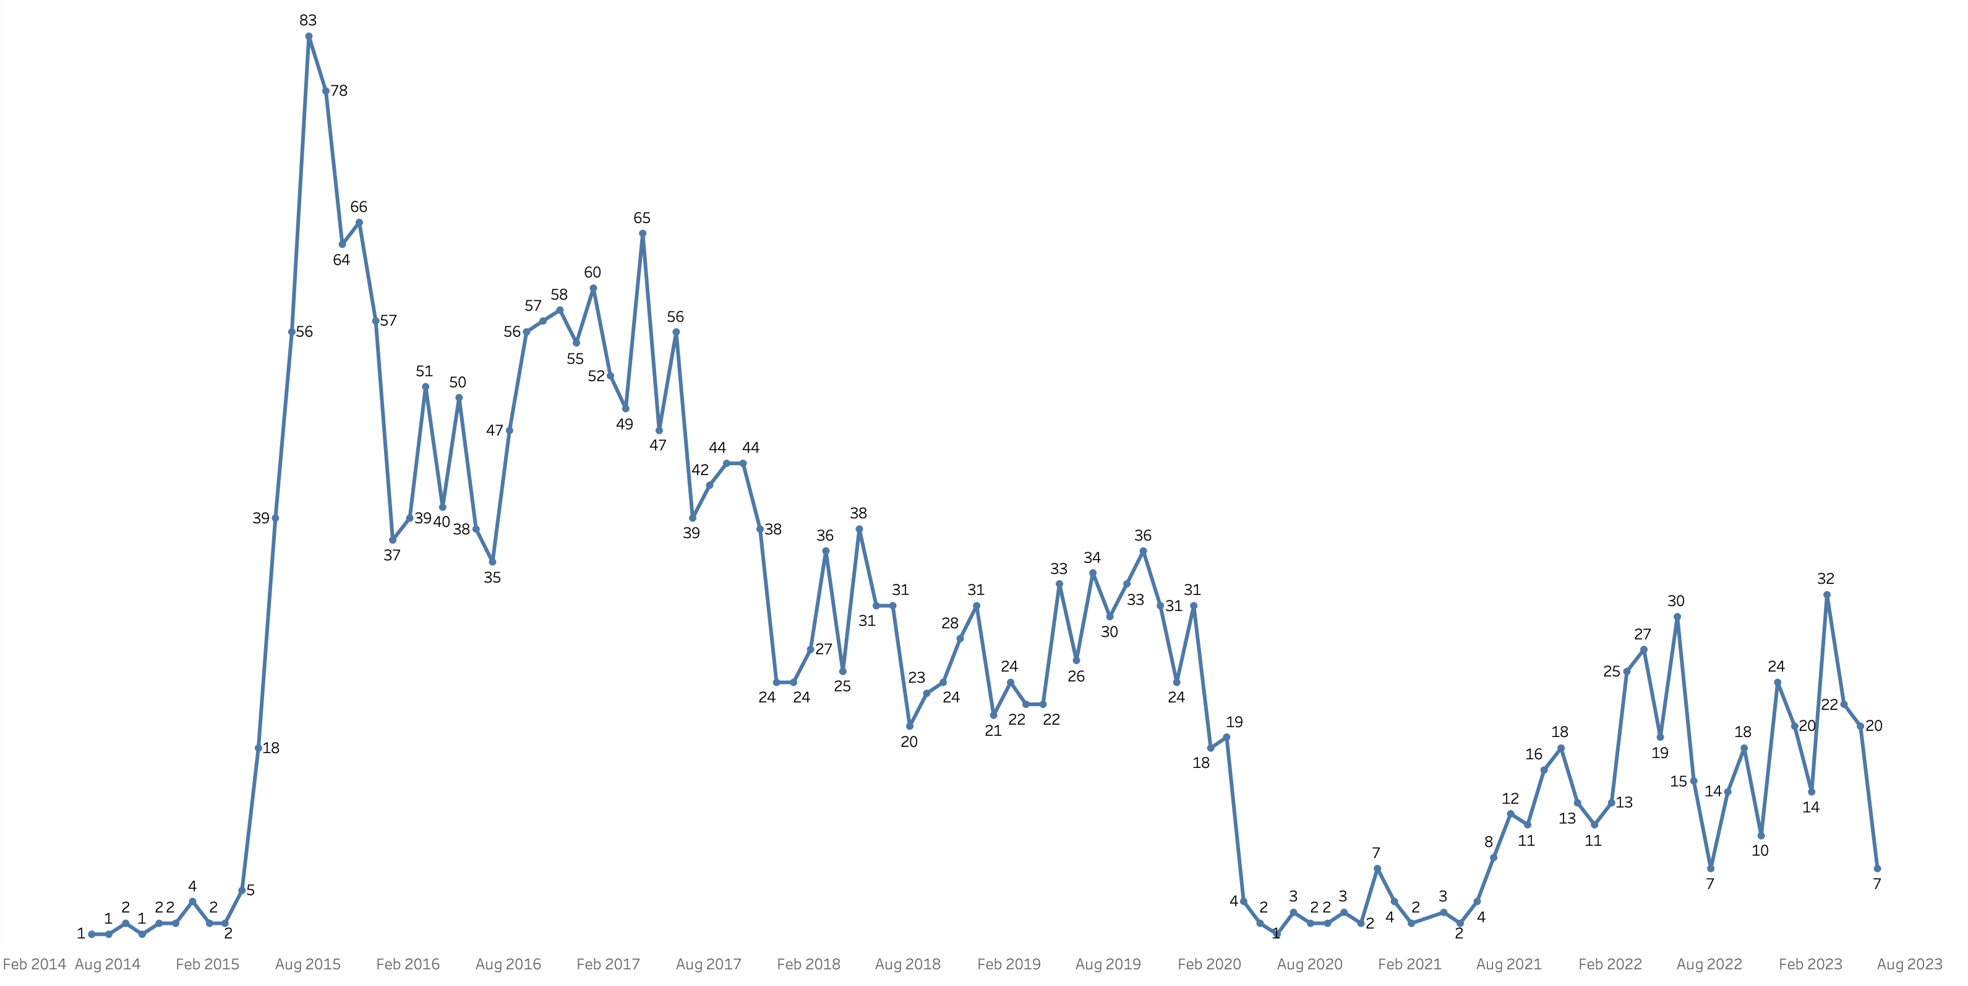
The Number of Comments Over the Date Flown
The Most Number of Comments were written in August 2015.
The Comment Count got decreased in 2020 due to the pandemic.

Slide 4
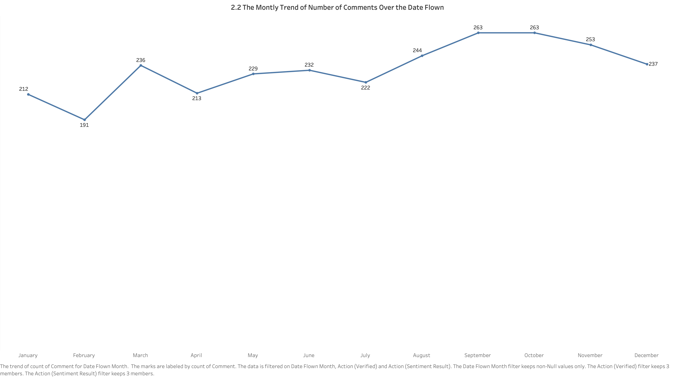
The Monthly Trend of The Number of Comments Over the Date Flown
As seen from the monthly trend, most of the passengers commented about the September flights, least is on February month.

Slide 5
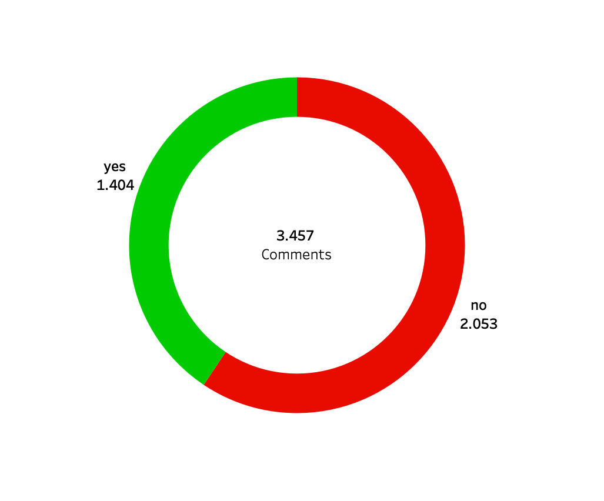
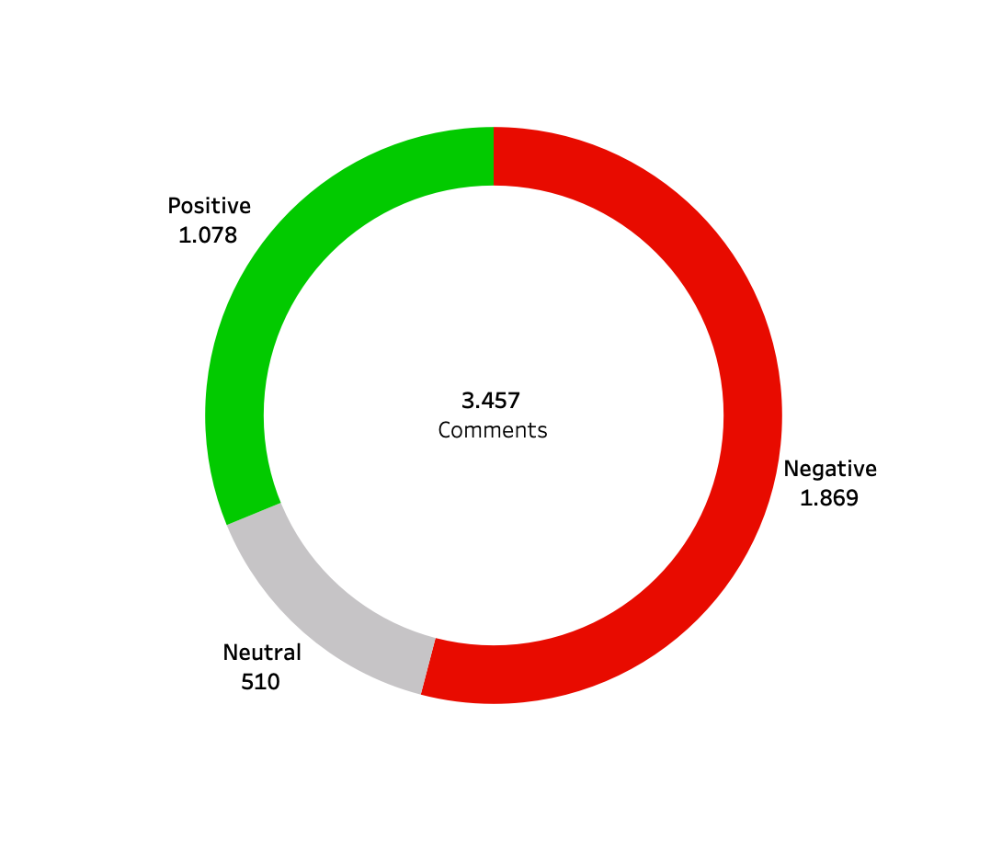
The Number of People Whether They Would Recomment British Airways
The Sentiment Analysis Results (RoBERTa Model) of The Comments
The overall opinion on Biritish Airways got more negative score and more than half of the people would not recommend it

Slide 6
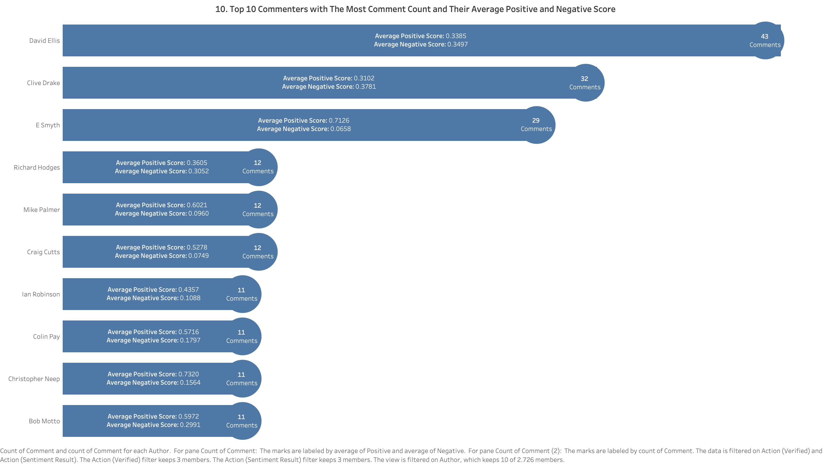
However, according to the analysis of the Authors with the most Comments, their average positive score is signitficantly higher than negative score

Slide 7
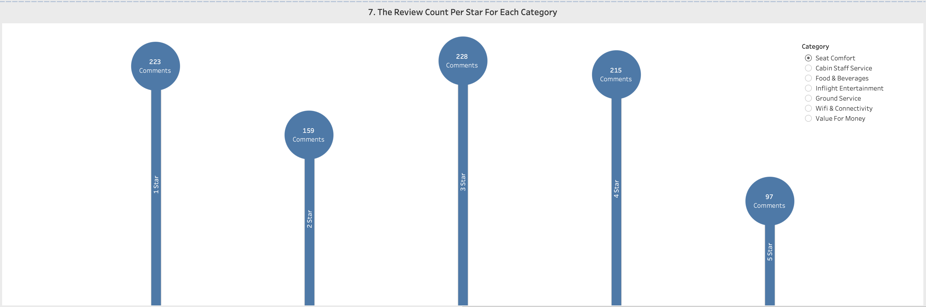
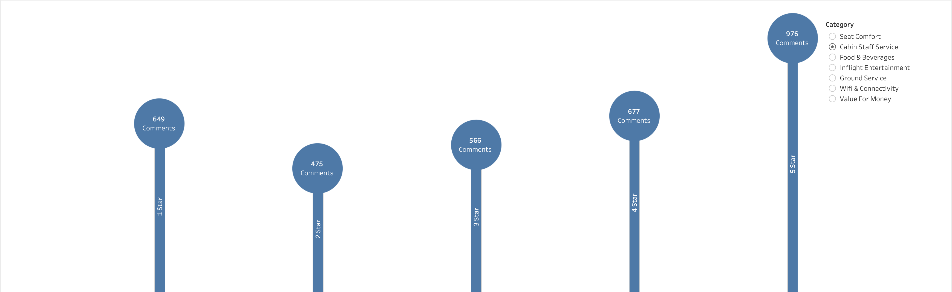
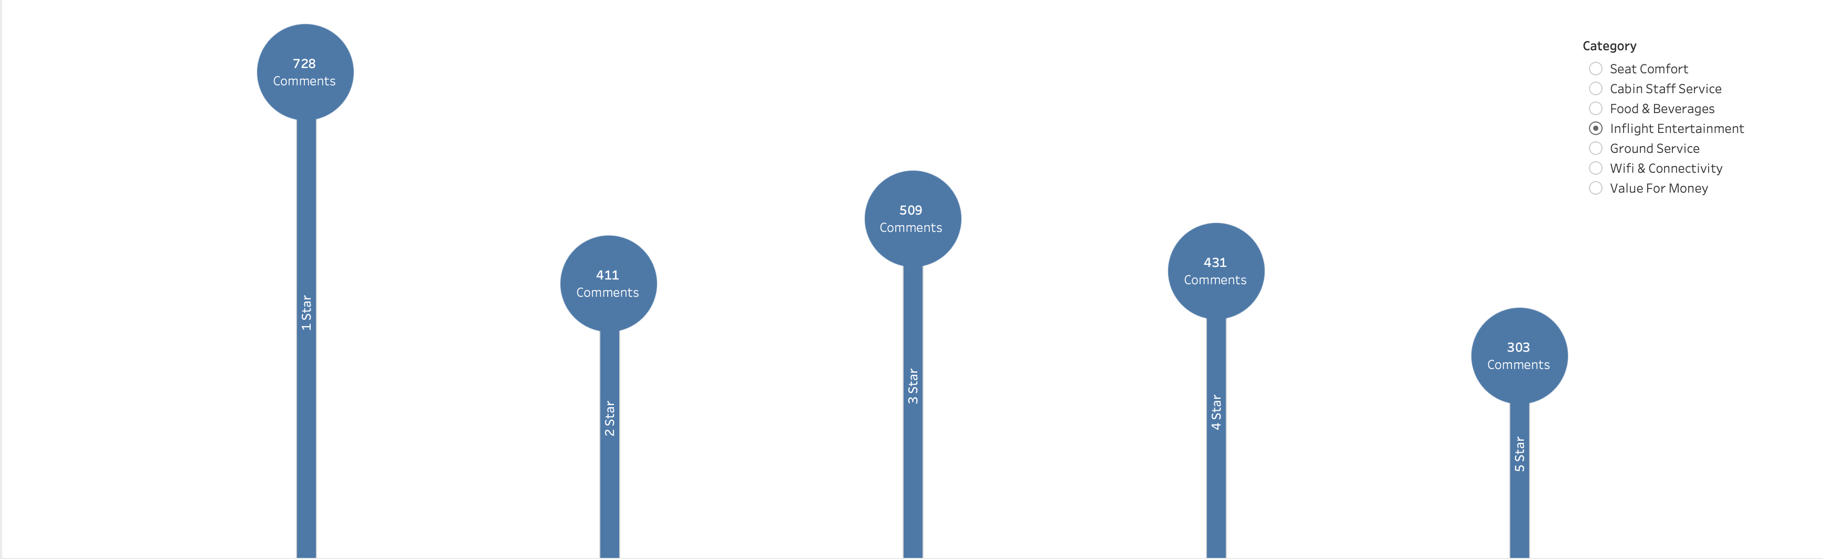
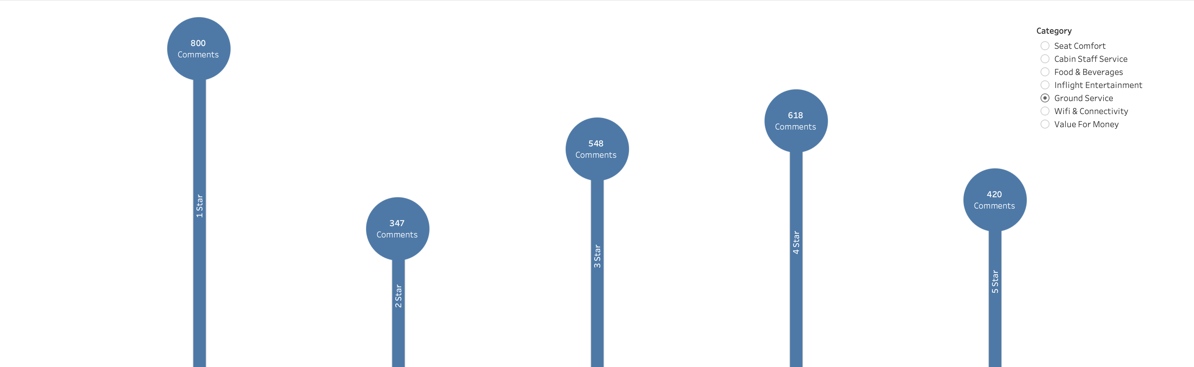
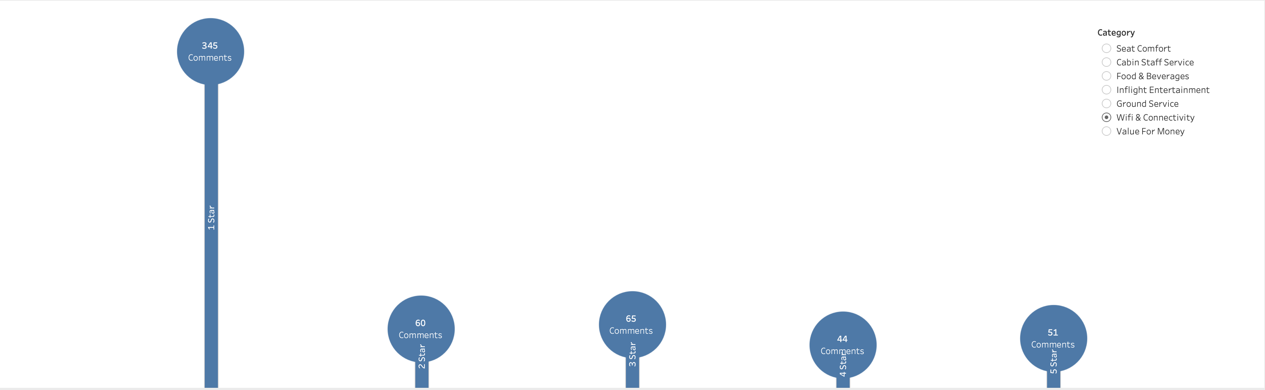
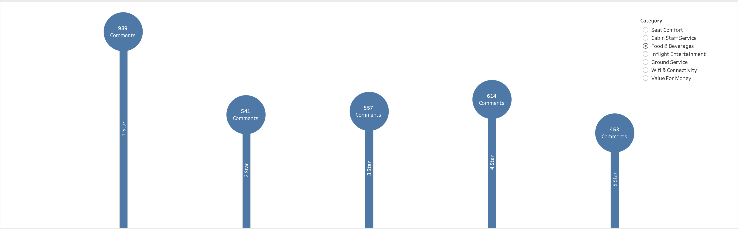
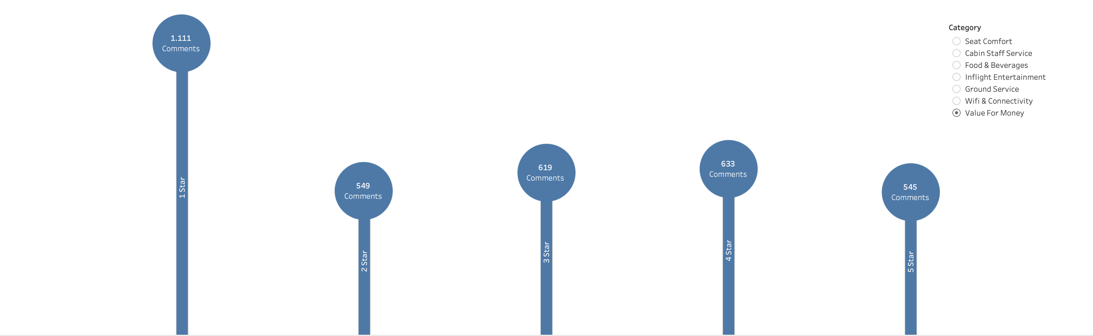
The Number of Reviews per Category Scored 1-5 Stars

Slide 8
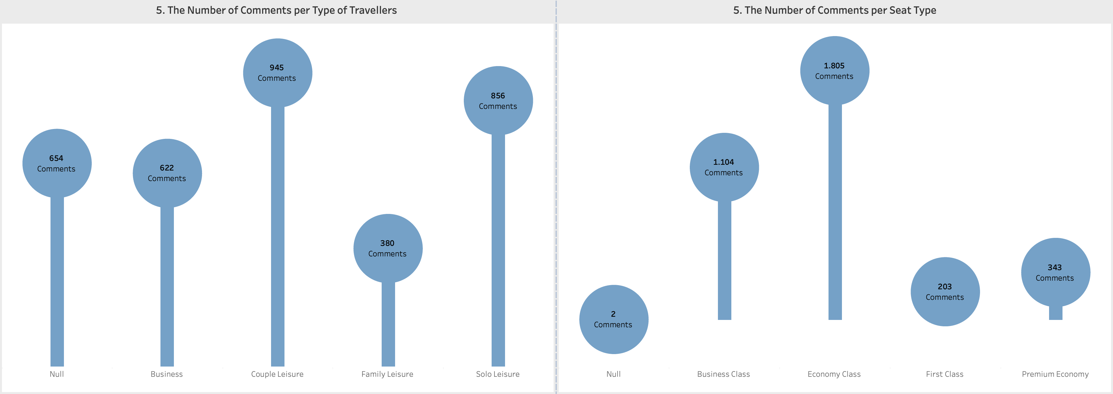
Most of the Commentes used Airlines for Couple Leisure Purposes and most of them flew Economy Class

Slide 9
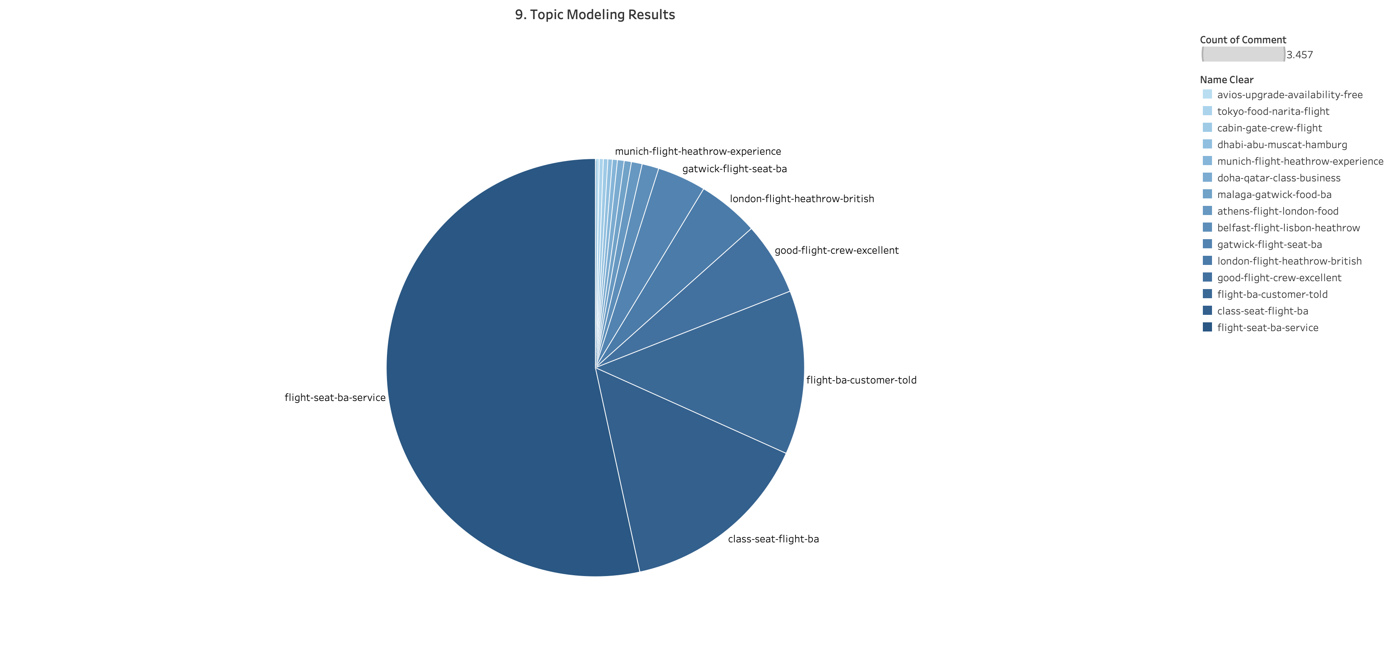
The Results of Topic Modeling (BERTopic Model), most of the talked topic is about seat service at British Airways

